Slide 1
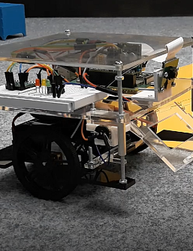
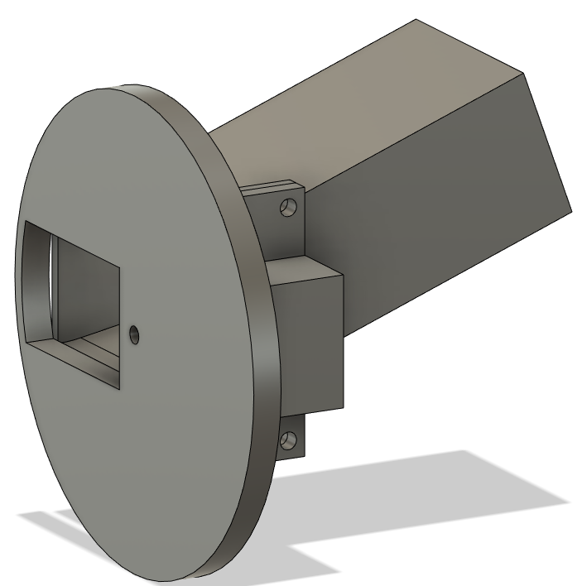
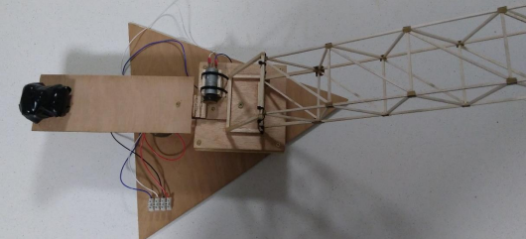
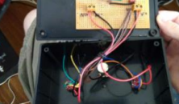
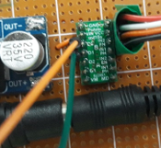
Engineering Project Portfolio
Hamish Daniels

Slide 2
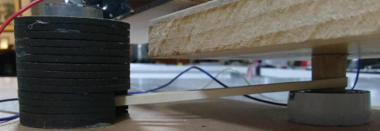
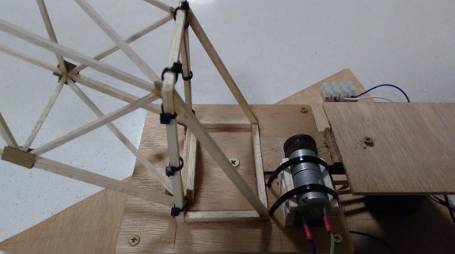
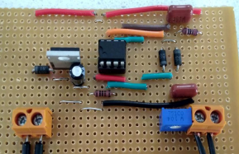
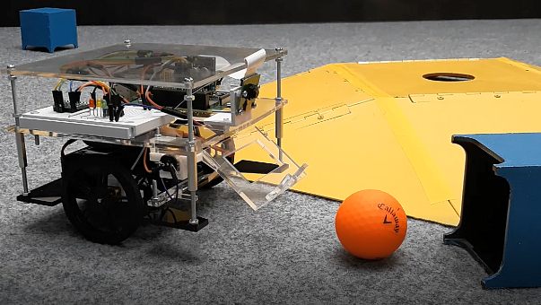
Past Projects include, designing and constructing:
A crane
Motor analysis
Cost analysis
Truss design
Working on Electrical and Mechanical
A mars rover collection system…
Including Mechanical, Electrical and Software elements
Integrating subsystems
Images of different parts of the crane designed and built in the first semester of my Engineering degree
Image showing the prototype Mars Rover with the sample collection system integrated together with the image and driving systems from 3rd year of Mechatronics Engineering Degree

Slide 3
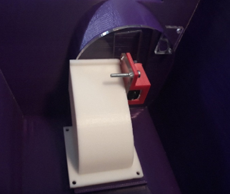
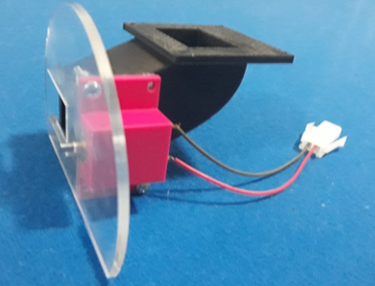
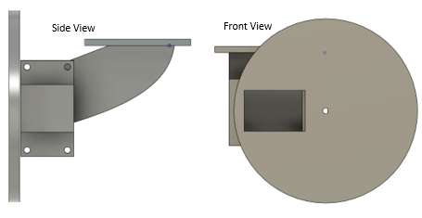
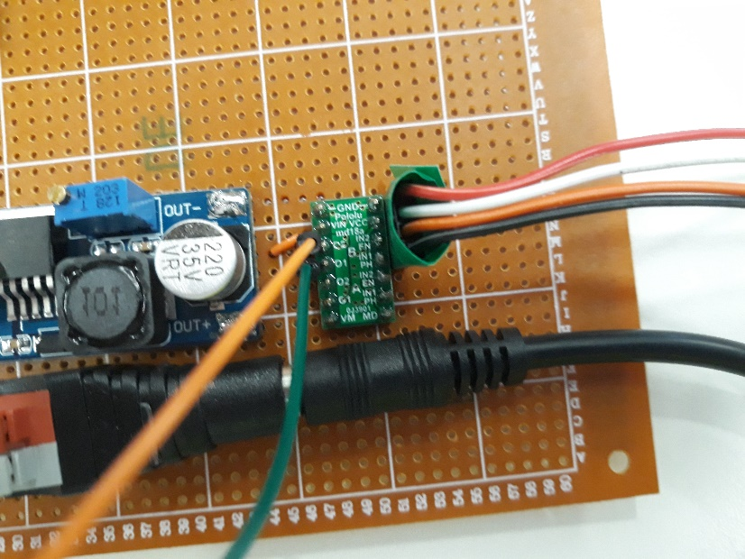
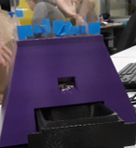
An Automatic Cat Feeder
Customer research for improvements to a design
Creating a component that fits and interacts with other components
Including Mechanical, Electrical and Software
Images showing different stages and iterations of the design and construction of the dispensing mechanism of an automatic cat feeder

